Slide 1

Scripting with ScriptForge
Jean-Pierre Ledure
jp@ledure.be
Notes:
Subject: Script + Forge
You know the meaning of Forge in SW Engineering
Basic + Python in square brackets: not for 1st release

Slide 2

Actual alternatives for task automation
~2,500 (partially) recordable commands
Documentation:
https://wiki.documentfoundation.org/Development/DispatchCommands
An API reference 'UNO" of ~20,000 entries
A complex object model with much abstraction
Documentation:
(Pitonyak) Macros explained 672 p.
(Marcelly/Godard) Macros OOoBASIC et API (french) 926 p.
BASIC
When the macro recorder is not able to solve a specific problem, the usual solution is to write code using the LibreOffice objects. Unfortunately, there is a steep learning curve for these LibreOffice objects. It is usually best to start with simple examples and then increase the scope of macros as you learn more.
LibreOffice 7.3 Getting Started Guide

Slide 3

ScriptForge : Targeted audience
Beginners frightened by UNO
Not UNO champions
Many people in-between

Slide 4

Not walls, bridges ...
Targets of the project
  Propose the same comprehensive set of services to Basic and Python users
  (except when the language offers them natively)
  Unify the user interfaces for exceptions, user interactions, debugging
  Hide UNO complexity
  Give fast access to UNO
  Apply best practices from similar API’s
  Propose well-written inspiring examples
Have MORE people
daring
MORE ambitious
automation

Slide 5
ScriptForge : Use cases
append a column to an array ? - remove duplicates from an array ? - print a Base form document ? - setup the
default printer ? - print a subset of the pages of a document ? - open a message box in Python ? - create a UNO
service in Python ? - determine the last used cell of a Calc sheet ? - know the list of the sheets contained in a
Calc document ? - import where you want a CSV file into a Calc sheet ? - copy a sheet ? - copy a sheet from
another document ? - copy a sheet from a closed document ? - get and set values in a sheet ? - get and set
formulas in a sheet ? - remove blank rows from a range of cells ? - open a range selector box ? - import data from
a database into a sheet ? - insert blank rows in a range of cells ? - create a chart ? Add a legend ? - execute a
SQL statement ? - get the content of a table, a query, a SQL SELECT statement ? - run a dialog in modal or non-modal
mode ? - run a dialog from a Python script - read/modify visibility and content of controls ? - manage a table
control in a dialog ? - feed a tree control in a dialog with data extracted from a database ? - manage name-value
pairs in Basic ? - handle sets of PropertyValues ? - open/close documents ? - print a document ? - create a new
menu in the menubar of a document ? - easily debug a Basic or a Python program ? - log what happens in my scripts -
know where LibreOffice is installed in the file system ? - know if extension XrayTool is installed on this system ? -
open a file picker and get the full path of the selected file ? - browse selectively files or folders ? - read all the
content of a text file at once ? - get the hashcode of a file ? - get and set data from/into a database with forms,
subforms, any type of control ? - deploy my extensions in several user languages ? - know the current operating
system, the current user name, the python version, … ? - open a nice popup menu when (right-)clicking on a
control in a dialog or a form ? - manage several locales ? - combine multiple timezones ? - get the result of a Calc
function in Basic or Python ? - send an email with attached files ? - find substrings by using regular expressions ?
- validate inputs in dialog boxes or forms ? - parse CSV files ? - know which documents are currently open ? -
make a document current ? - create a new Base/Firebird document ? - write in the status bar ? - convert numbers to letters ?
HOW TO … ?

Slide 6
List of services (24.8)
Category | Services
LibreOffice Basic | Array Dictionary | String UnitTest
Document | Base Calc Chart | Document FormDocument Writer
Database | Database Dataset | Datasheet Form FormControl
User interface | Dialog DialogControl UI | Menu PopupMenu Toolbar ToolbarControl
Utilities | Basic Exception FileSystem L10N Platform | Region Session TextStream Timer
https://help.libreoffice.org/latest/en-US/text/sbasic/shared/03/lib_ScriptForge.html?DbPAR=BASIC
Notes:
Agenda:
- an intro about ScriptForge
- resolve an existential question: smart to … ? (actually mix of Basic + Python, vaste majority in Basic)
- Service and Framework go together: the code is subdivided in services, their integration is done via a framework
- Details about 1st release
- What is next ...

Slide 7
ScriptForge – Release 24.8 – Services and their relationships
  Array
  Dialog
  Dictionary
  Exception
  L10N
  Platform
  PopupMenu
  Region
  Session
  String
  Timer
  Document
  Calc
  FormDocument
  Writer
  Menu
  Toolbar
  Base
  ToolbarButton
CreateScriptService()
  Form
  Database
  FormControl
  Dataset
  Datasheet
  UI
  FileSystem
  TextStream
  Dialog
  DialogControl
Notes:
This is what will be shipped with LO 7.1
- the core library and 3 associated libraries (much smaller at this stage)
SFDocuments is a library, Calc is a service
- one LO online help page by service
an introduction
how is the service invoked, with which arguments
the properties
the methods and their arguments
all with examples
- a POT file with all labels in english => see later

Slide 8
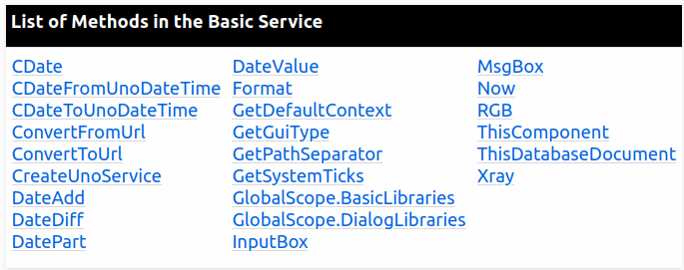
ScriptForge extends the Python language
The “Basic” service
The Basic service methods reproduce in Python the exact syntax and behaviour (*) of Basic builtin functions
(*) Dates are datetime.datetime instances
basic = CreateScriptService(‘basic’)
txt = basic.InputBox(‘Please enter a phrase:‘, ‘Dear user’)
basic.MsgBox(txt, basic.MB_ICONINFORMATION, ‘Confirmation of phrase’)
basic.CreateUnoService(‘com.sun.star.util.PathSubstitution‘)

Slide 9


ScriptForge supplies the execution context
Architecture ComputerName CPUCount
CurrentUser Extensions FilterNames
Fonts FormatLocale Machine
OfficeLocale OfficeVersion OSName
OSPlatform OSRelease OSVersion
Printers Processor PythonVersion
SystemLocale
ConfigFolder Extension(s)Folder HomeFolder
InstallFolder TemplatesFolder TemporaryFolder
UserTemplatesFolder
Country Currency DatePatterns
DateSeparator DayAbbrevNames DayNames
DayNarrowNames DecimalPoint Language
ListSeparator MonthAbbrevNames MonthNames
MonthNarrowNames ThousandSeparator TimeSeparator
Platform
FileSystem
Region
(by any locale)

Slide 10

ScriptForge is international
The L10N service: PO-Files dissociate the two very different profiles involved in the process, i.e. the programmer and the translator(s)
Ideal for extensions
The Region service
Converts timezones and calculates Daylight Saving Time offsets
region.DSTOffset, LocalDateTime, TimeZoneOffset, UTCDateTime, UTCNow
Transforms numbers into text
region.Number2Text
reg = CreateScriptService(‘Region’)
utcTime = reg.UTCNow(‘Europe/Berlin’, ‘DE’)
numText = reg.Number2Text(73, ‘fr-BE’)
Notes:
Very briefly:
PO files are Portable Objects.
POT files are Portable Object Templates
The POT file is built by the developer in the reference language, typically english, and contains the labels and room for translated strings.
Each translator produces his/her PO file after having filled in the empty places with the translated strings.
A directory gathers all PO files. One of those files is opened at run-time for the user interface being in the user’s own language.
For the time being, SF itself is shipped with a POT file and only 1 (en) PO file.

Slide 11
ScriptForge supports complex debugging contexts (1)
When mouse hovers ScrollBar1, next script is triggered
def ControlEvent(poEvent = None):
ctl = CreateScriptService(‘DialogEvent’, poEvent)
if ctl is not None:
exc = CreateScriptService(‘exception’)
exc.DebugPrint('Event triggered from Python in control', \ ctl.Name, 'of dialog', ctl.Parent.Name)
Python code
When mouse hovers ScrollBar2, next script is triggered
Sub ControlEvent(Optional poEvent As Object)
Dim ctl, exc
Set ctl = CreateScriptService("DialogEvent", poEvent)
If Not IsNull(ctl) Then
Set exc = CreateScriptService("exception")
exc.DebugPrint( _
"Event triggered from Basic in control", ctl.Name, _
"of dialog", ctl.Parent.Name)
End If
End Sub
Basic code

Slide 12
ScriptForge supports complex debugging contexts (2)

Slide 13

ScriptForge: gems in Calc (1)
A “range” is a superset of the usual definition of a cells range:
  “~”, “~.~“ the current selection
  “~.someRangeName” a range name at sheet level
  “Sheet1.*” all used cells in the given sheet
Many methods have a range (as a string) as input argument
Many methods return a range (as a string)
A1Style, CompactLeft, CompactUp, CopyToCell, CopyToRange, CreatePivotTable, ImportFromCSVFile, MoveRange, Offset, OpenRangeSelector, Printf, Region, SetArray, SetValue, SetFormula, ShiftDown, ShiftLeft, ShiftRight, ShiftUp, SortRange
… make it easier to manage ranges of unknown/variable/unpredictable sizes

Slide 14

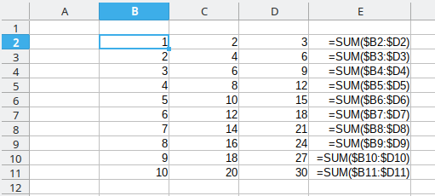

ScriptForge: gems in Calc (2)
Example:
reg = calc.Region(‘B2’) # $Sheet1.$B$2:$D$11
sum = ‘=SUM($%C1%R1:$%C2%R1)’ # Placeholders: %C2 = last column etc.
formula = calc.Printf(sum, reg) # =SUM($B2:$D2)
formularange = calc.Offset(reg, columns = calc.Width(reg), width = 1)
# $Sheet1.$E$2:$E$11
calc.SetFormula(formularange, formula)

Slide 15
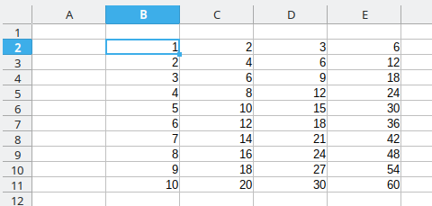
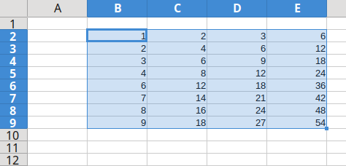
ScriptForge: gems in Calc (3)
Row, column and cell filters
calc.ClearAll, ClearFormats, ClearValues, CompactLeft, CompactUp, SetCellStyle
reg = calc.Region(‘B2’) # $Sheet1.$B$2:$E$11
newrange = calc.CompactUp(reg, wholerow = True, filterformula = ‘=MOD($E2;10)=0’)
# $Sheet1.$B$2:$E$9
calc.CurrentSelection = newrange

Slide 16

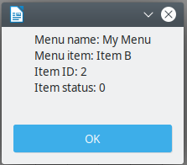
ScriptForge: menus
menu = doc.CreateMenu(menuheader, before=””, submenuchar=”>”)
menu.AddItem(MenuItem, [Name=""], [Icon=""], [Tooltip=""], [command=””], [script=””]
menu.AddRadioButton(…, [status = False], ...)
menu.AddCheckBox(..., [status = False], ...)
basic = CreateScriptService("Basic")
def create_menu():
doc = CreateScriptService("Document", basic.ThisComponent)
menu = doc.CreateMenu("My Menu")
menu.AddItem("Item A", command="About")
menu.AddItem("Item B",
script="vnd.sun.star.script:my_macros.py$item_b_listener?...”)
menu.Dispose()
def item_b_listener(args):
s_args = args.split(",")
msg = f"Menu name: {s_args[0]}\n" + f"Menu item: {s_args[1]}\n" \
+ f"Item ID: {s_args[2]}\n" + f"Item status: {s_args[3]}"
basic.MsgBox(msg)

Slide 17
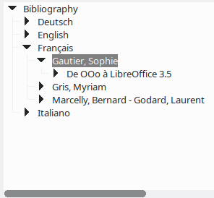
ScriptForge: a TreeControl in a Dialog (1)
Flat tree >>>> Resulting subtree
A1 B1 C1 |__ A1
A1 B1 C2 |__ B1
A1 B2 C3 |__ C1
A2 B3 C4 |__ C2
A2 B3 C5 |__ B2
A3 B4 C6 |__ C3
|__ A2
|__ B3
|__ C4
|__ C5
|__ A3
|__ B4
|__ C6
A treecontrol is good at visualizing tabular data
Node expansion can be done statically or dynamically
# Extract data from the database
db = CreateScriptService(‘Database’, ‘’, ‘Bibliography’)
sql = """SELECT [Custom1], [Author], [Title] FROM [biblio] WHERE [Author] IS NOT NULL ORDER BY [Custom1], [Author], [Title]"""
data = db.GetRows(sql)
db.CloseDatabase

Slide 18
ScriptForge: a TreeControl in a Dialog (2)
Methods
treecontrol.CreateRoot, AddSubNode, AddSubTree, FindNode
Properties
treecontrol.CurrentNode
Events
treecontrol.OnNodeSelected, OnNodeExpanded
Static or dynamic (sub)tree
dialog = CreateScriptService(‘Dialog’, ‘GlobalScope’, library, dialog)
tree = dialog.Controls(‘theTree’)
root = tree.CreateRoot(‘Bibliography’) # com.sun.star.awt.tree.XMutableTreeNode
# Extract data from the database
data = … # see previous slide
# Build the tree
tree.AddSubTree(root, data)
tree.CurrentNode = tree.FindNode(‘*Sophie*’, casesensitive = False)
tree.XControlView.expandNode(tree.CurrentNode)
# Display the dialog
dialog.Execute()

Slide 19

ScriptForge: charts (1)
basic = CreateScriptService("Basic")
ui = CreateScriptService('ui')
fs = CreateScriptService('FileSystem')
from scriptforge import CreateScriptService
basic = CreateScriptService("Basic")
ui = CreateScriptService('ui')
fs = CreateScriptService('FileSystem')

Slide 20
ScriptForge: charts (2)
basic = CreateScriptService("Basic")
ui = CreateScriptService('ui')
fs = CreateScriptService('FileSystem')
# Get data
db = CreateScriptService('database', registrationname = 'Bibliography')
sql = 'SELECT [Custom1] AS [Language], [Identifier] FROM [biblio] ORDER BY [Language] ASC'
data = db.GetRows(sql, header = True)
db.CloseDatabase()
# Get data
db = CreateScriptService('database', registrationname = 'Bibliography')
sql = 'SELECT [Custom1] AS [Language], [Identifier] FROM [biblio] ORDER BY [Language] ASC'
data = db.GetRows(sql, header = True)
db.CloseDatabase()

Slide 21
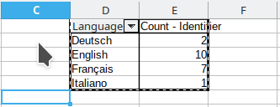
ScriptForge: charts (3)
basic = CreateScriptService("Basic")
ui = CreateScriptService('ui')
fs = CreateScriptService('FileSystem')
# Get data
db = CreateScriptService('database', registrationname = 'Bibliography')
sql = 'SELECT [Custom1] AS [Language], [Identifier] FROM [biblio] ORDER BY [Language] ASC'
data = db.GetRows(sql, header = True)
db.CloseDatabase()
# Import data in Calc
calc = ui.CreateDocument('Calc', hidden = True)
datarange = calc.SetArray('Sheet1.A1', data)
pivot = calc.CreatePivotTable('Pivot1', datarange, targetcell = 'D1', datafields = 'Identifier;Count',
rowfields = 'Language', rowtotals = False, columntotals = False, filterbutton = False)
# Import data in Calc
calc = ui.CreateDocument('Calc', hidden = True)
datarange = calc.SetArray('Sheet1.A1', data)
pivot = calc.CreatePivotTable('Pivot1', datarange, targetcell = 'D1', datafields = 'Identifier;Count',
rowfields = 'Language', rowtotals = False, columntotals = False, filterbutton = False)

Slide 22
ScriptForge: charts (4)
basic = CreateScriptService("Basic")
ui = CreateScriptService('ui')
fs = CreateScriptService('FileSystem')
# Get data
db = CreateScriptService('database', registrationname = 'Bibliography')
sql = 'SELECT [Custom1] AS [Language], [Identifier] FROM [biblio] ORDER BY [Language] ASC'
data = db.GetRows(sql, header = True)
db.CloseDatabase()
# Make and export chart
chart = calc.CreateChart('NumberByLanguage', 'Sheet1', pivot, rowheader = True,
columnheader = True)
chart.ChartType, chart.Dim3D, chart.Legend = 'Pie', True, True
file = fs.GetTempName() + '.png'
chart.ExportToFile(file, 'PNG')
calc.CloseDocument(False)
# Import data in Calc
calc = ui.CreateDocument('Calc', hidden = True)
datarange = calc.SetArray('Sheet1.A1', data)
pivot = calc.CreatePivotTable('Pivot1', datarange, targetcell = 'D1', datafields = 'Identifier;Count',
rowfields = 'Language', rowtotals = False, columntotals = False, filterbutton = False)
# Make and export chart
chart = calc.CreateChart('NumberByLanguage', 'Sheet1', pivot, rowheader = True, columnheader = True)
chart.ChartType, chart.Dim3D, chart.Legend = 'Pie', True, True
file = fs.GetTempName() + '.png'
chart.ExportToFile(file, 'PNG')
calc.CloseDocument(False)

Slide 23
ScriptForge: charts (5)
basic = CreateScriptService("Basic")
ui = CreateScriptService('ui')
fs = CreateScriptService('FileSystem')
# Get data
db = CreateScriptService('database', registrationname = 'Bibliography')
sql = 'SELECT [Custom1] AS [Language], [Identifier] FROM [biblio] ORDER BY [Language] ASC'
data = db.GetRows(sql, header = True)
db.CloseDatabase()
# Import data in Calc
calc = ui.CreateDocument('Calc', hidden = True)
datarange = calc.SetArray('Sheet1.A1', data)
pivot = calc.CreatePivotTable('Pivot1', datarange, targetcell = 'D1', datafields = 'Identifier;Count',
rowfields = 'Language', rowtotals = False, columntotals = False, filterbutton = False)
# Make and export chart
chart = calc.CreateChart('NumberByLanguage', 'Sheet1', pivot, rowheader = True, columnheader = True)
chart.ChartType, chart.Dim3D, chart.Legend = 'Pie', True, True
file = fs.GetTempName()
chart.ExportToFile(file, 'PNG')
calc.CloseDocument(False)
# Display chart in dialog (or form …)
dialog = CreateScriptService('Dialog', container = 'GlobalScope',
library = 'xx', dialogname = 'xxx')
dialog.Controls('ImageControl1').Picture = file
dialog.Execute()
# Display chart in dialog (or form …)
dialog = CreateScriptService('Dialog', container = 'GlobalScope', library = 'xx', dialogname = 'xxx')
dialog.Controls('ImageControl1').Picture = file
dialog.Execute()

Slide 24


Thank you …
The team
    Jean-Pierre Ledure, Rafael Lima, Alain Romedenne,Paul Moss
Documentation
    https://help.libreoffice.org/latest/en-US/text/
    sbasic/shared/03/lib_ScriptForge.html?DbPAR=BASIC
Sources
    https://gitlab.com/LibreOfficiant/scriptforge
    Gerrit
Telegram groups
    ScriptForge
    LibreOffice Macros & Scripting

